Slide 1
Potato Blight Disease Prediction

Slide 2
Major Learning
Using CNN to predict the kind of Diseases Potato Plant is having and model a model
Data Augmentation
Data Scaling

Slide 3
Methodology
Uploading the Data in TensorFlow Input Pipeline
Resizing the image
Splitting data into train, validation and test
Taking Data in Cache, Scaling Data and performing Data Augmentation
Preparing the model and performing Pr

Slide 4
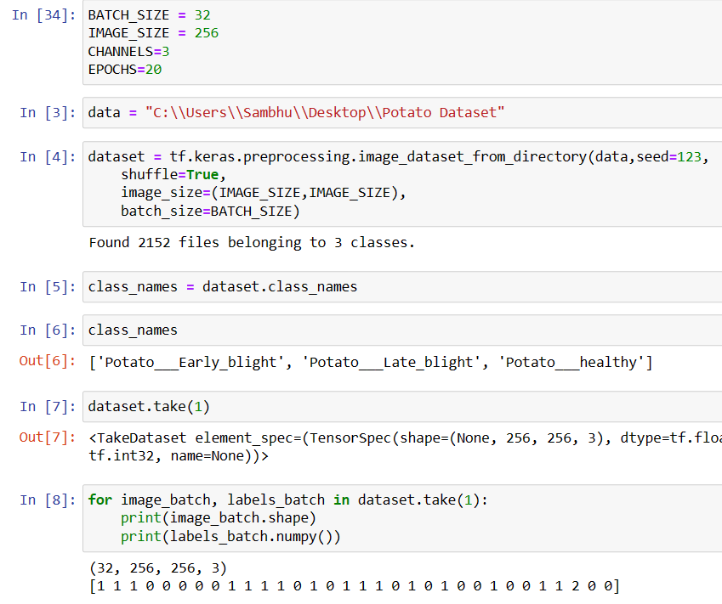

Slide 5
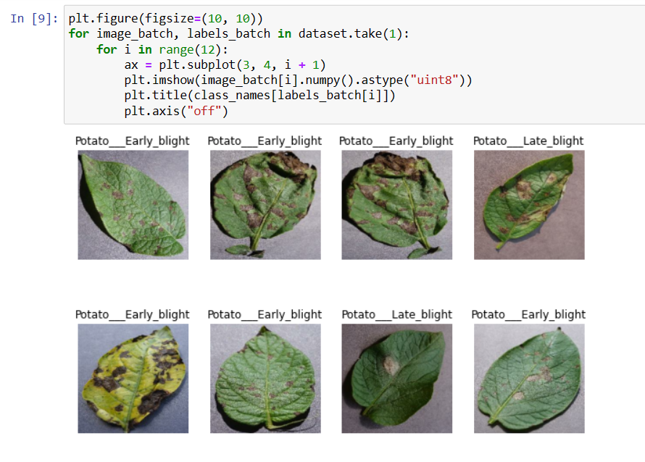

Slide 6
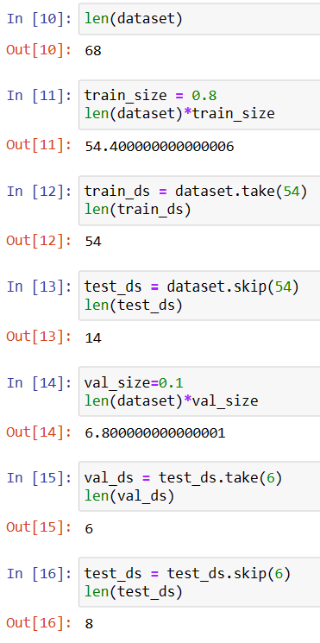

Slide 7
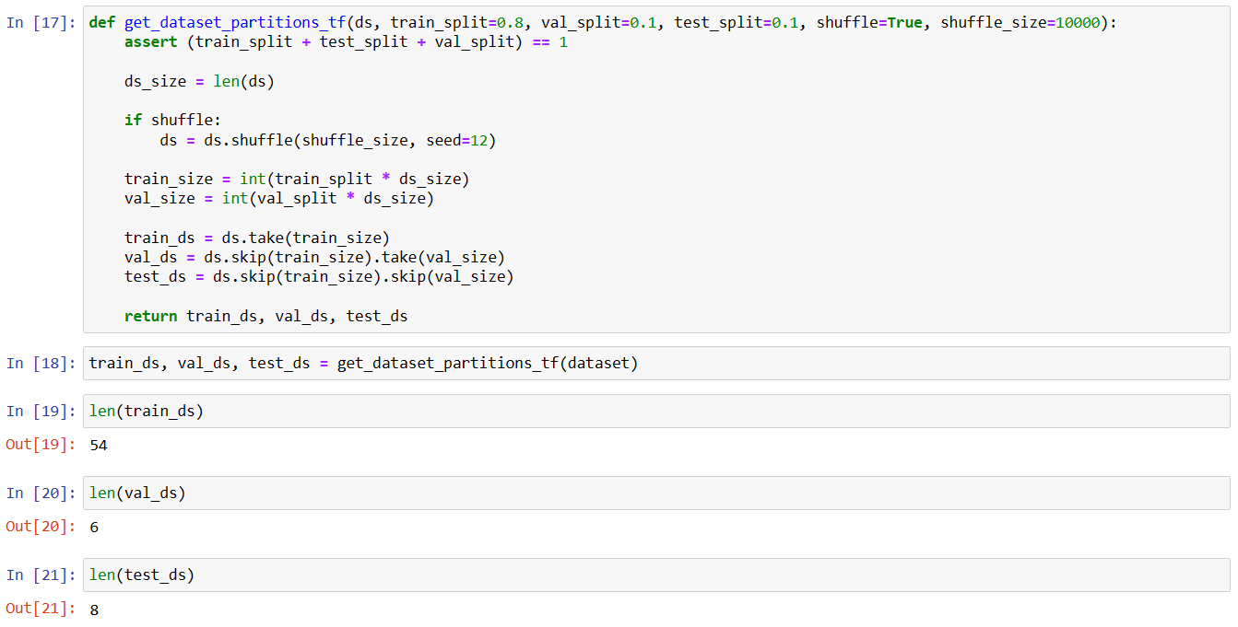

Slide 8
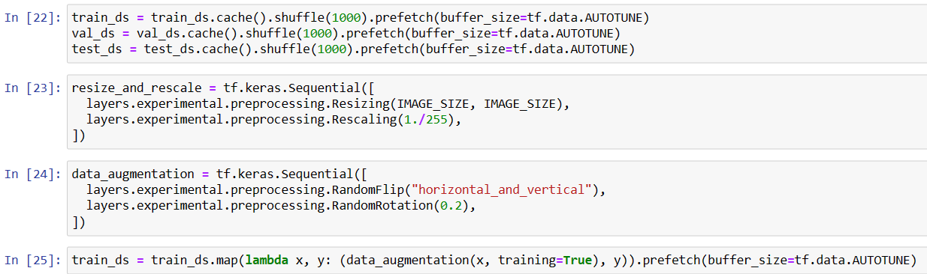

Slide 9
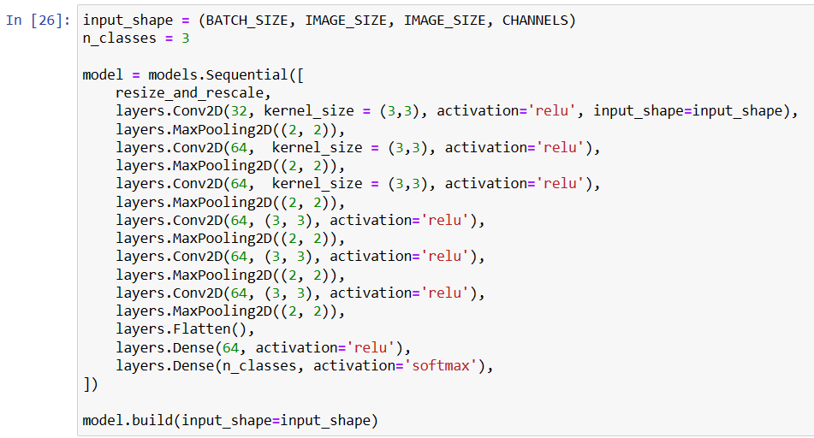

Slide 10
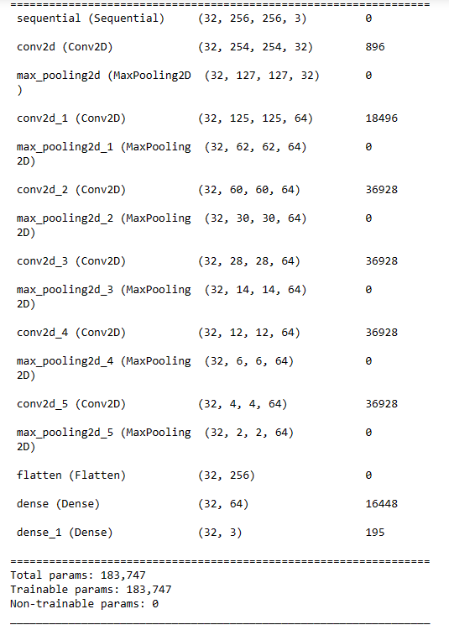
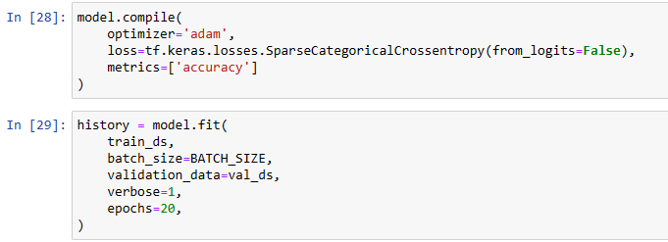

Slide 11
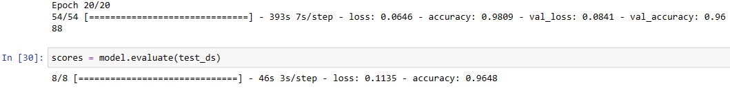

Slide 12
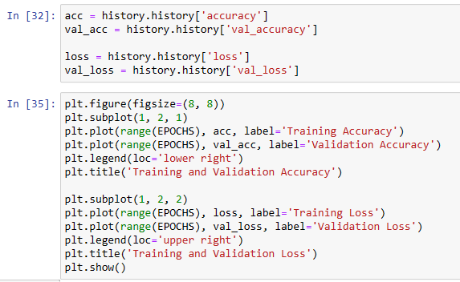
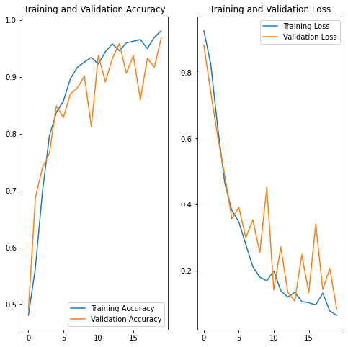

Slide 13
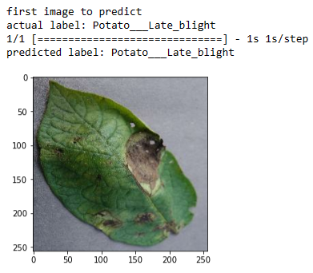
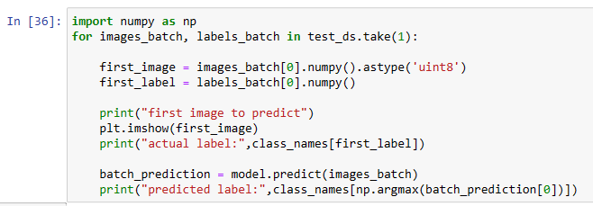

Slide 14
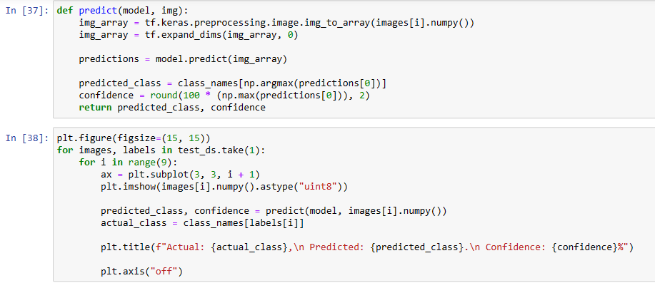
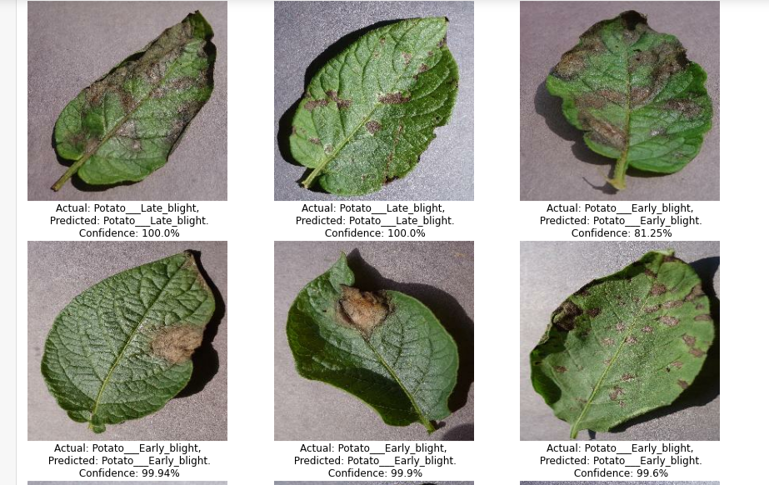

Slide 15
Implementation
This project will help the company to identify the type of diseases the potato plant is having and can remotely direct farmers that which plant should be given what type of medication before its too late and company faces loss of production.

